Slide 1

My Path in Medicine
March 14, 2018
Jack McDonnell, MD
Pediatric Hospitalist

Slide 2
College

Slide 3
BW College
No fancy University status back then
Attended 2001-2016
Piano Performance Major
Took medical school prerequisite coursework as well
Almost went to music graduate school instead of medical school
In retrospect, this would have been a mistake!
Notes:
Had to drop Dr. Joe’s anatomy class because it was TOO MUCH WORK

Slide 4
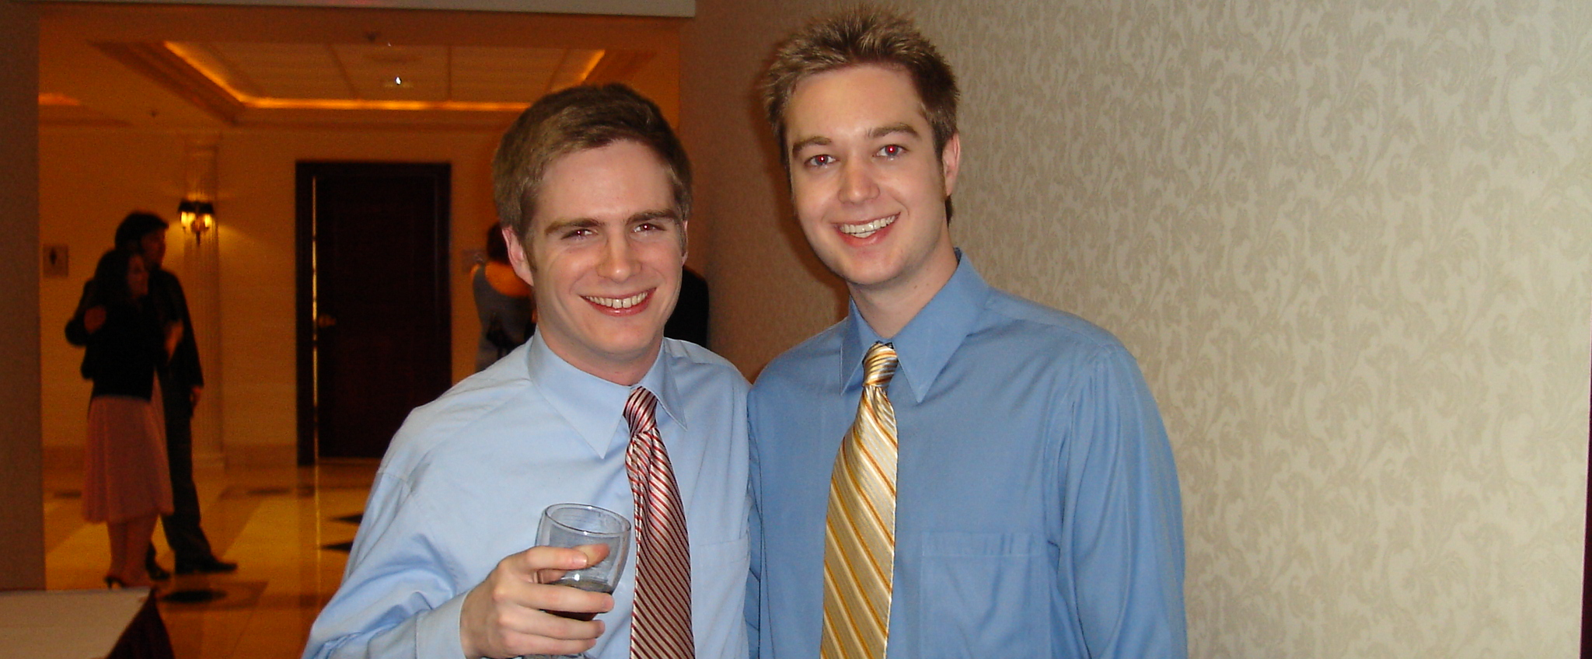

Slide 5
Medical School

Slide 6
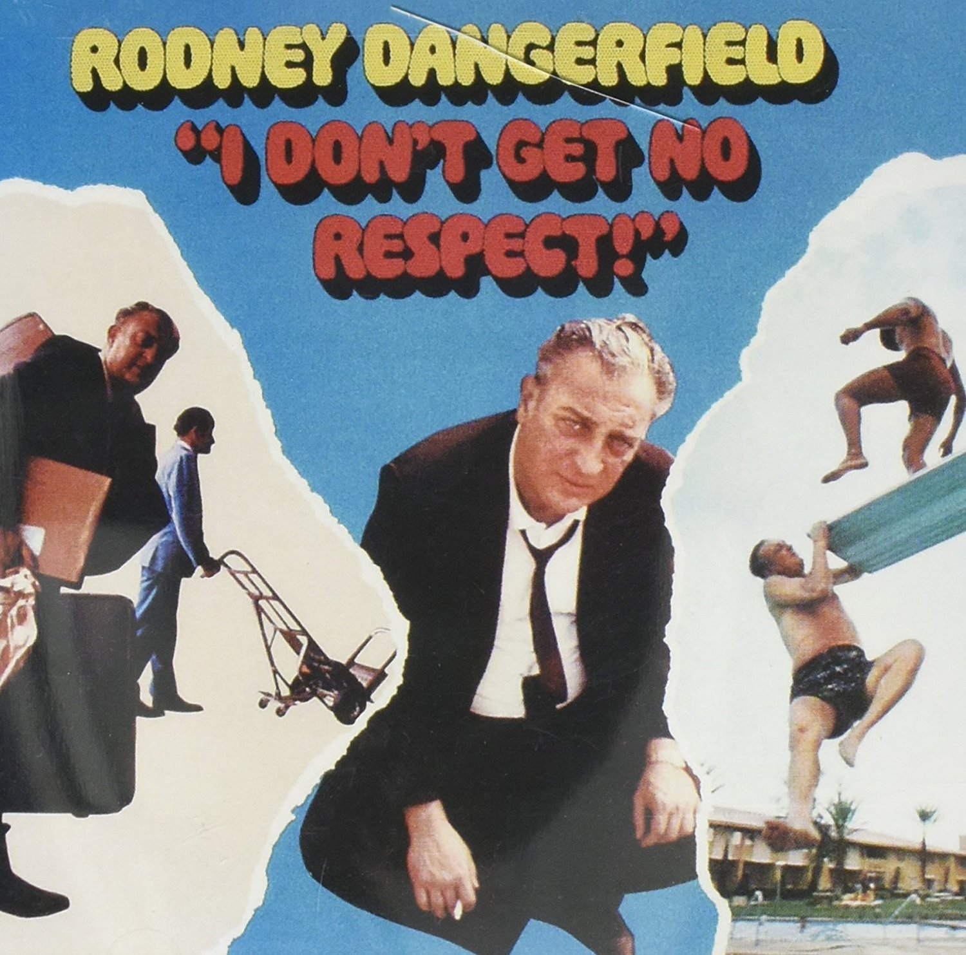
MCO->MUO->UTCOM
MEDStart Program
Early admission, got in junior year
Challenging days

Slide 7
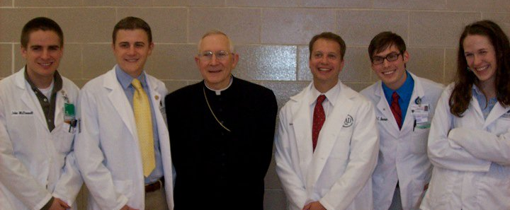

Slide 8
Residency

Slide 9
Walter Reed National Military Medical Center
Pediatric Residency
GREAT experience
Much better than medical school (for me)
Learned a lot of medicine, made some lasting friendships
OBSTACLES

Slide 10
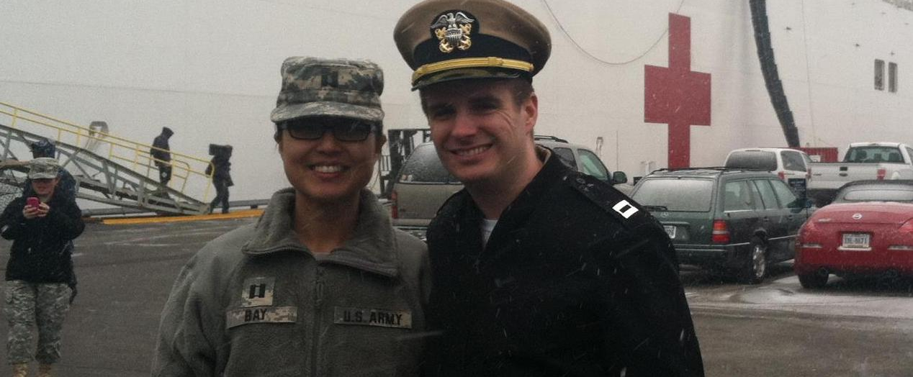

Slide 11
Beyond

Slide 12
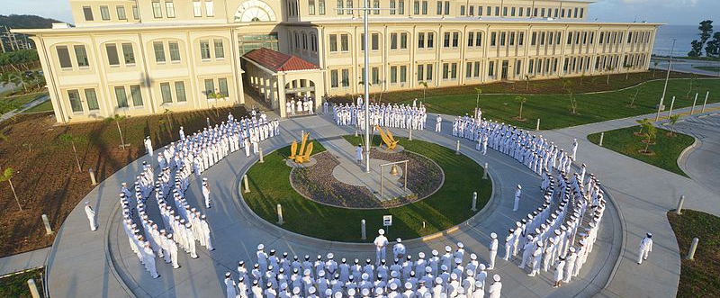
Naval Hospital Guam

Slide 13
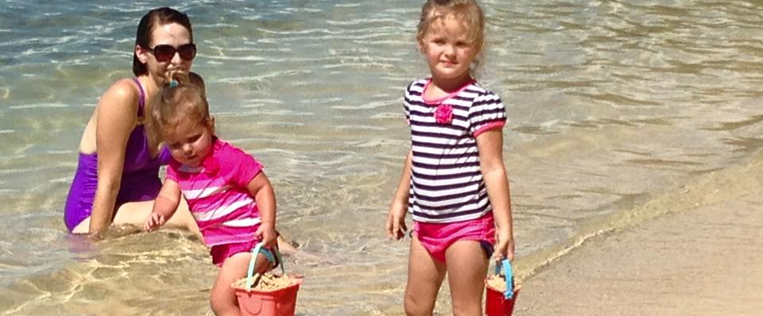
At the beach . . .

Slide 14

Guam = beautiful

Slide 15
NH Guam
First “staff tour” after residency
Remote duty station
1 pediatric subspecialist on the entire island (NICU)
Difficult patients with little help
Nearest transfer center was 12 hour flight
On the plus side . . . great for clinical skills

Slide 16
Now – back in Ohio

Slide 17
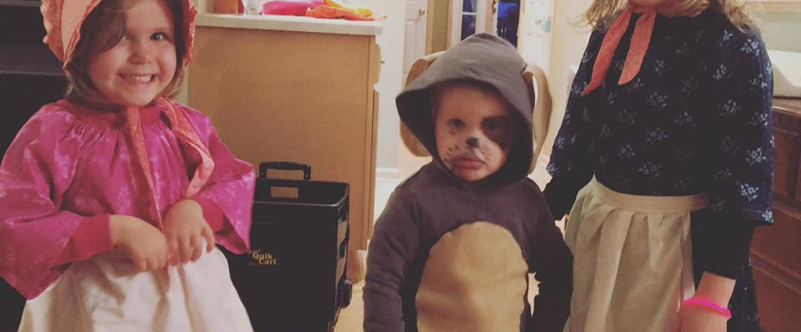
3 kids

Slide 18
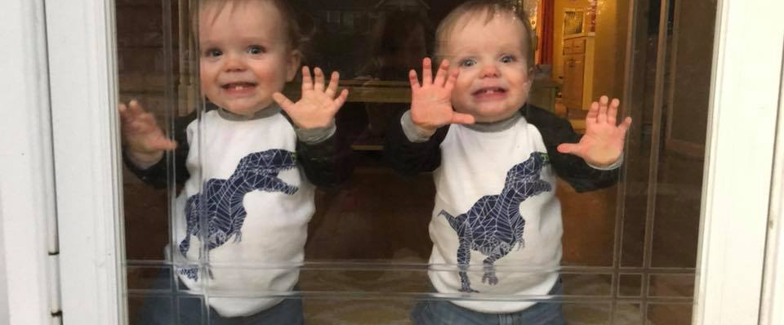
+2

Slide 19
What I am up?
Full-time pediatric hospitalist at Cleveland Clinic
Mostly work at Fairview Hospital
Resuscitating babies + general peds admissions
MS student in Biostatistics at Case
WEIRD being back in school
Notes:
Had to drop Dr. Joe’s anatomy class because it was TOO MUCH WORK

Slide 20
Typical Day at Work
Day Shift from 0800-1700
Sign-out, then round on 40+ babies and 10+ pediatric inpatient team
LOTS of help, including CC residents, CWRU and CC medical students
Nurse Practitioners
Night Shift 1700-0800
Busy – lots of calls from ERs, deliveries
Notes:
Had to drop Dr. Joe’s anatomy class because it was TOO MUCH WORK

Slide 21
Realizations/Advice

Slide 22
Med School
Med school is HARD
People who have always excelled will feel inadequate
As a student you will just feel you are in the way
Don’t kid yourself, you actually ARE in the way most of the time
BUT . . .you are also ESSENTIAL
Epidemic of mental health issues/suicide

Slide 23
Residency
Residency is HARDER (in a different way)
Not all programs follow work-hour restrictions
Even if they do you will be exhausted
Patients will die, you will feel like you let them down
Getting feedback hurts

Slide 24
Attending
Congrats, no more work hours!!!
Congrats, you are now completely responsible for each patient!!!
Congrats, you are also responsible for each trainee’s education!!!
ADVICE -Be humble, get help, keep learning

Slide 25
Questions?

